Slide 1
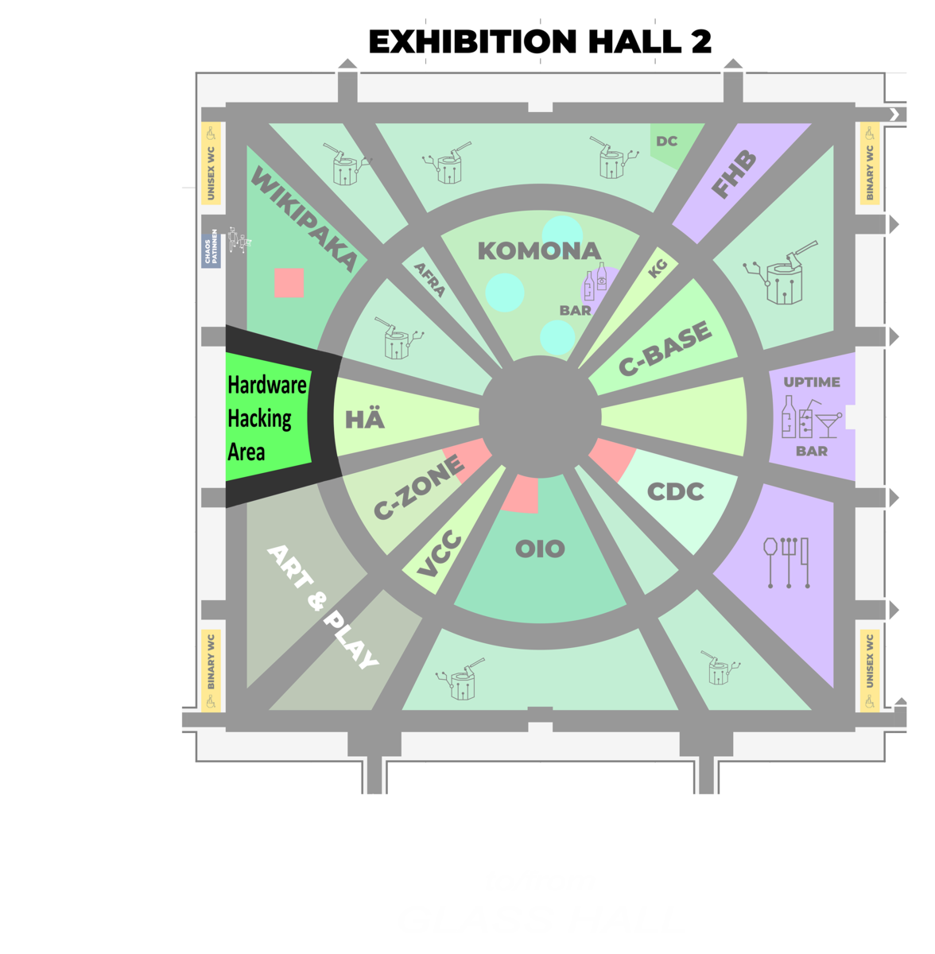
36C3: Hardware Hacking
Workshops in the Hardware Hacking area
Emily Hammes

Slide 2
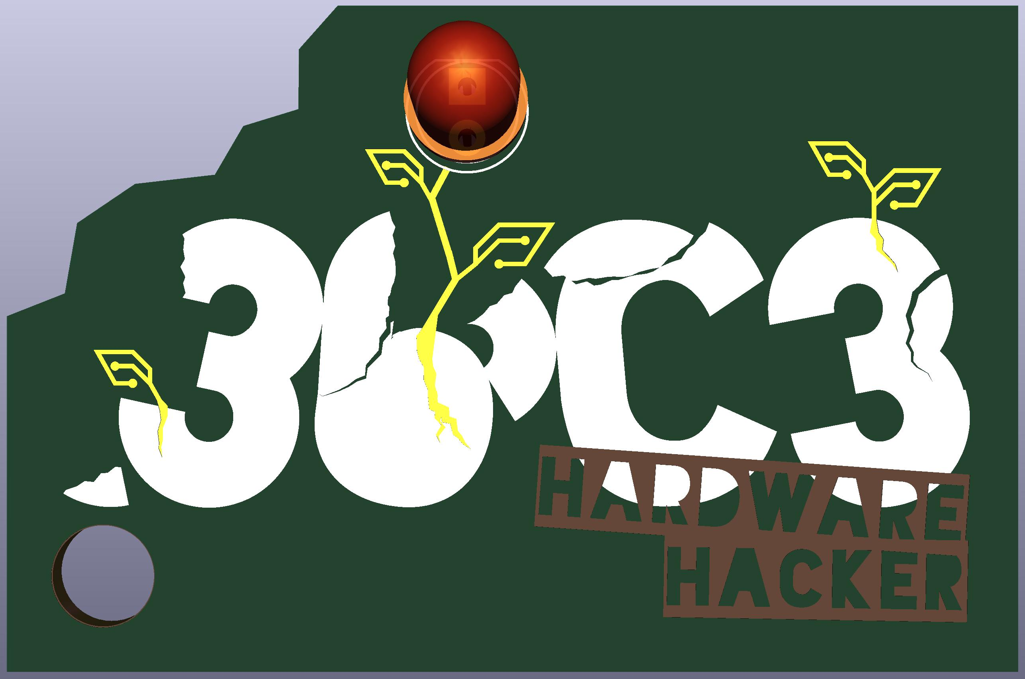
Continuous Soldering: 30-100+ soldering irons
Open to everyone
Bring things to Solder
Kits for sale (30+ types!)
36C3 Hardware Hacker by Donation
Make projects like this sustainable!
Donate!

Slide 3
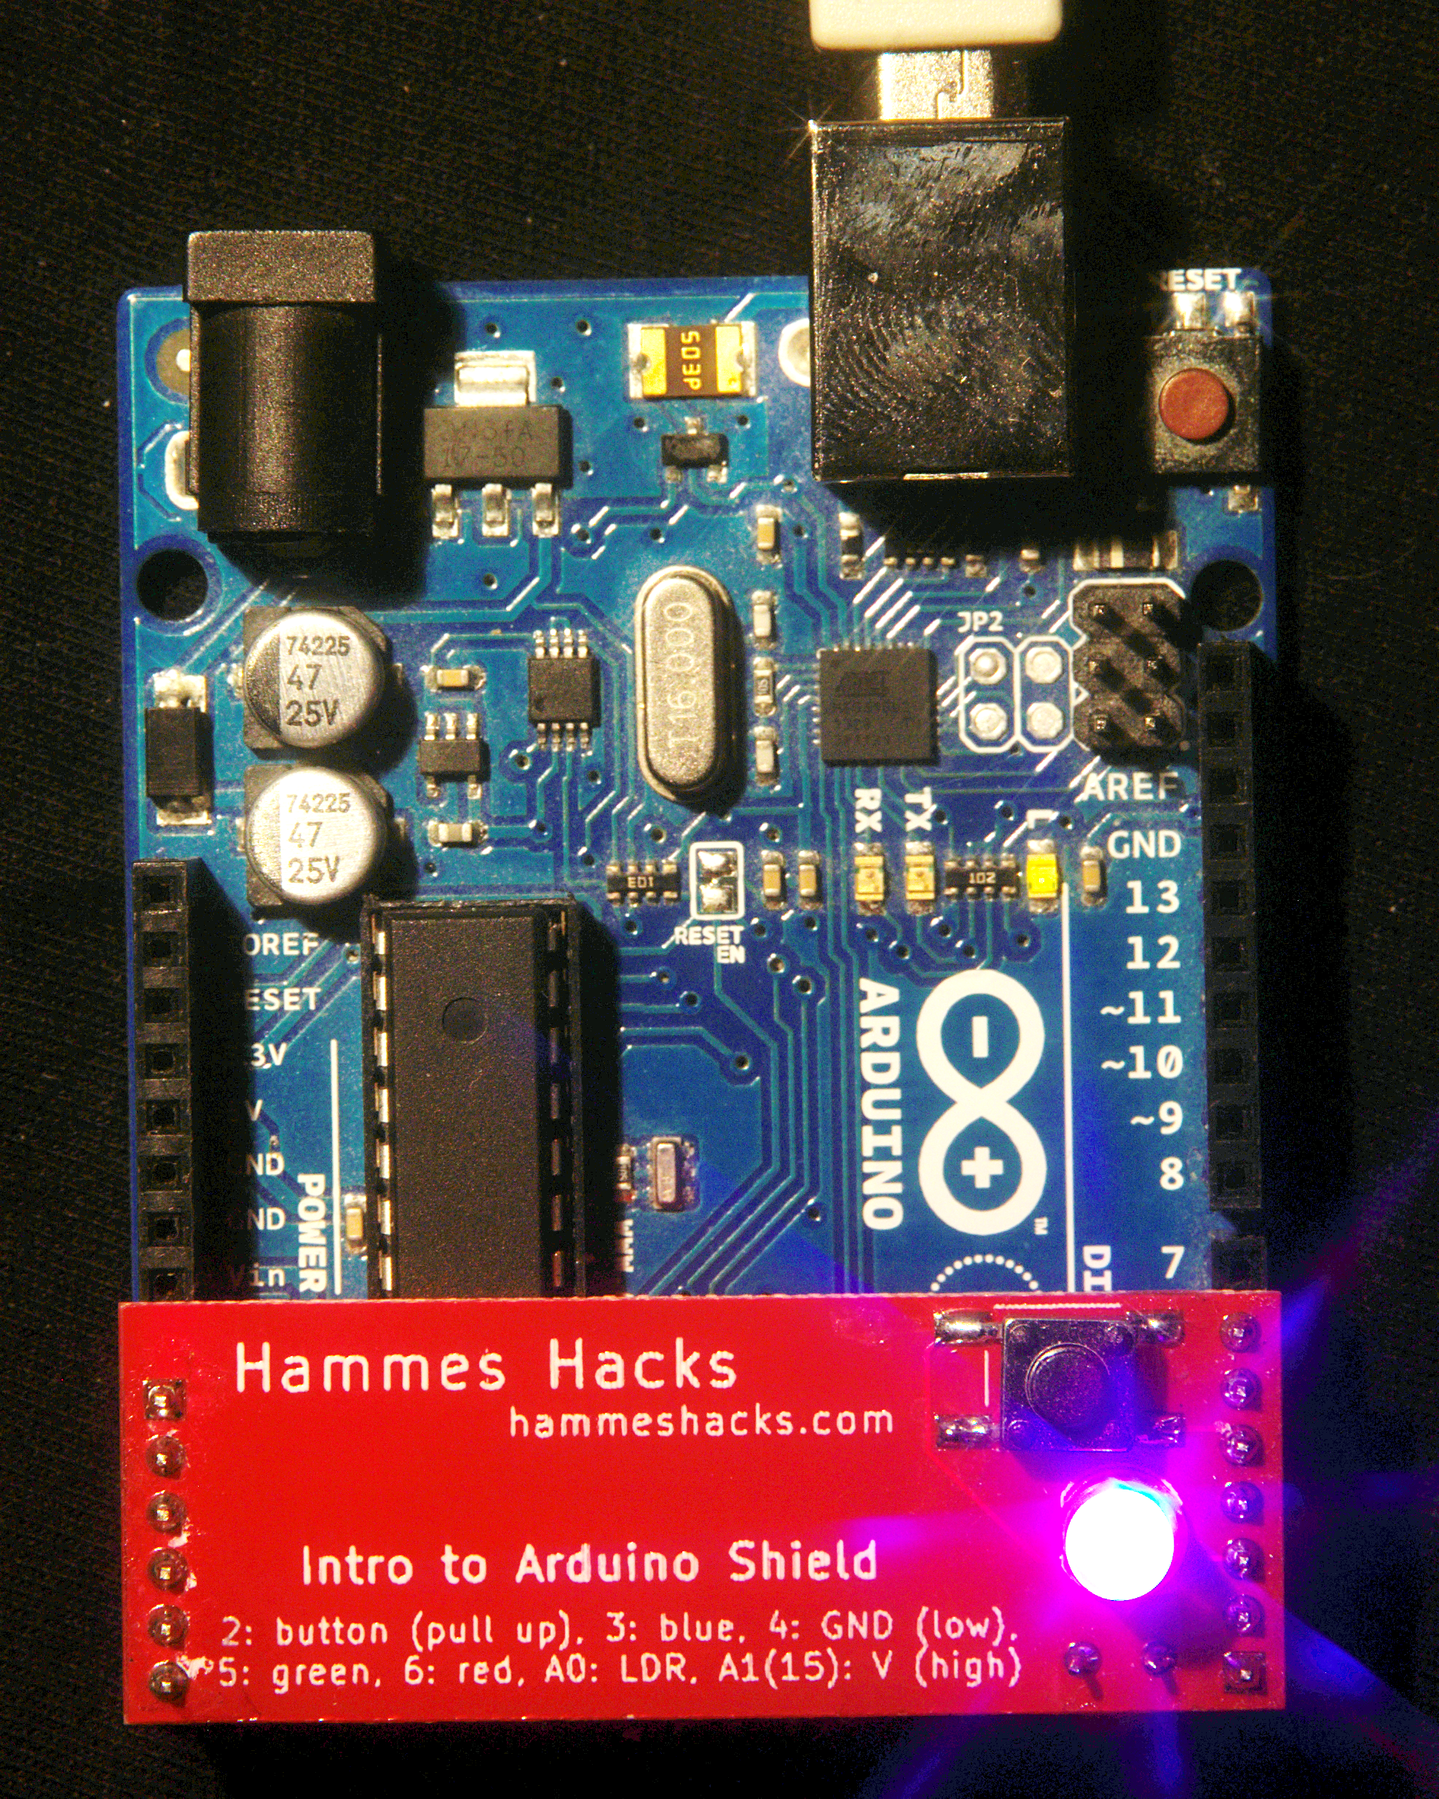
Intro To Arduino Shield: Soldering And Programming
1 hour soldering a shield
1 hour programming the shield
I will help you until yours
25/35 Euro
Day 2 + Day 3, 17:30-20:00 Day 4, 15:00-17:30

Slide 4
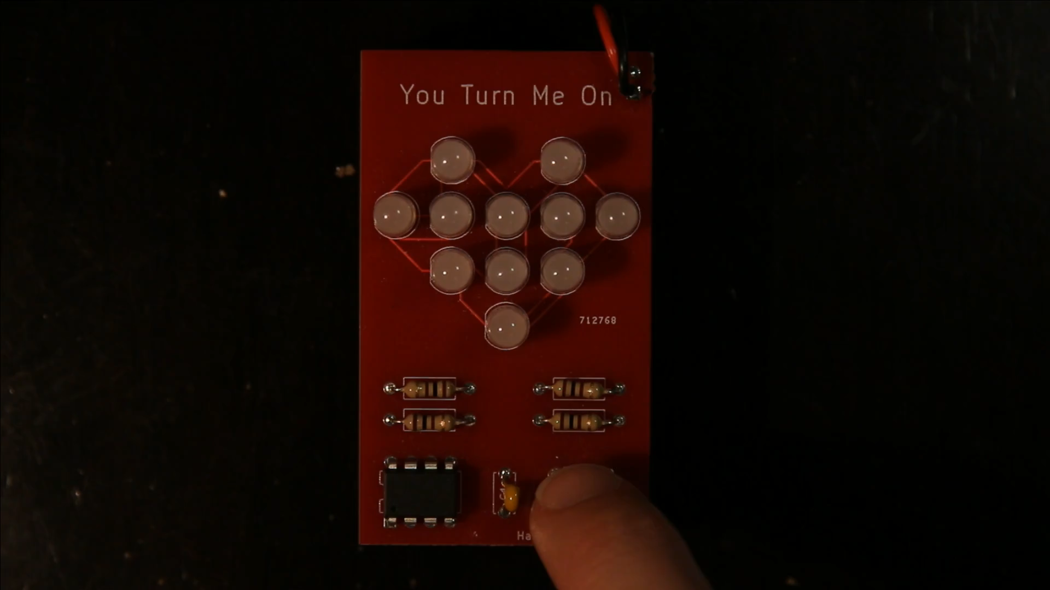
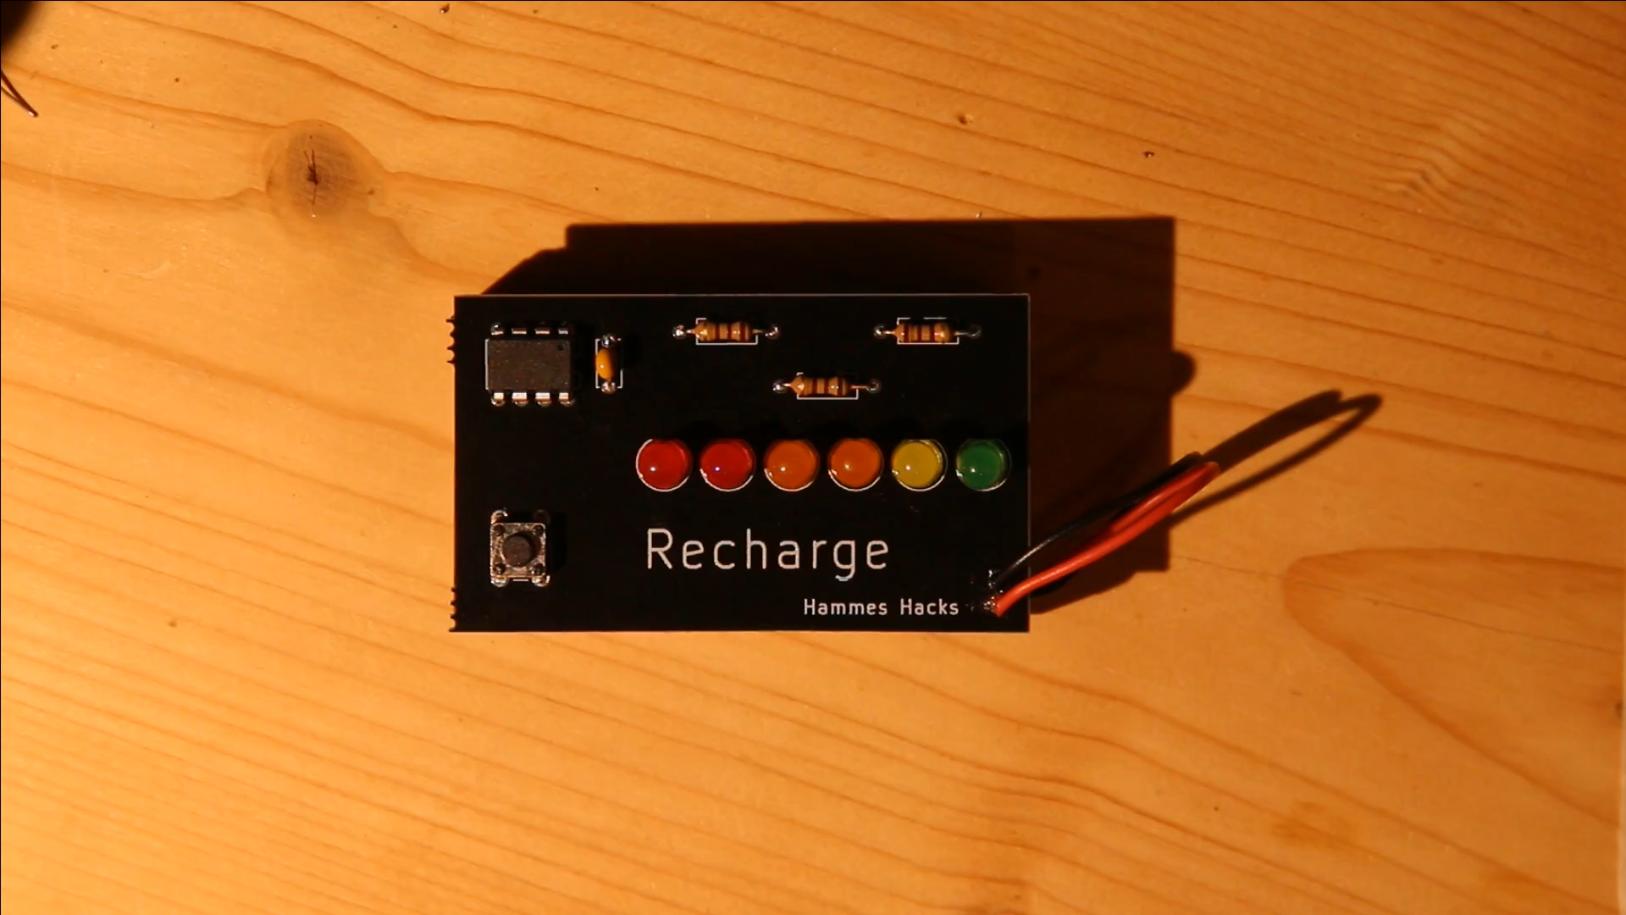
Soldering For Beginners: LED Toy Löten für Einsteiger: Wir bauen ein LED-Spielzeug
Solder a Recharge or a You Turn Me On kit (student choice)
Löten ein Recharge oder ein You Turn Me On kit
Day 3/Tag 3, 21:00-23:00

Slide 5
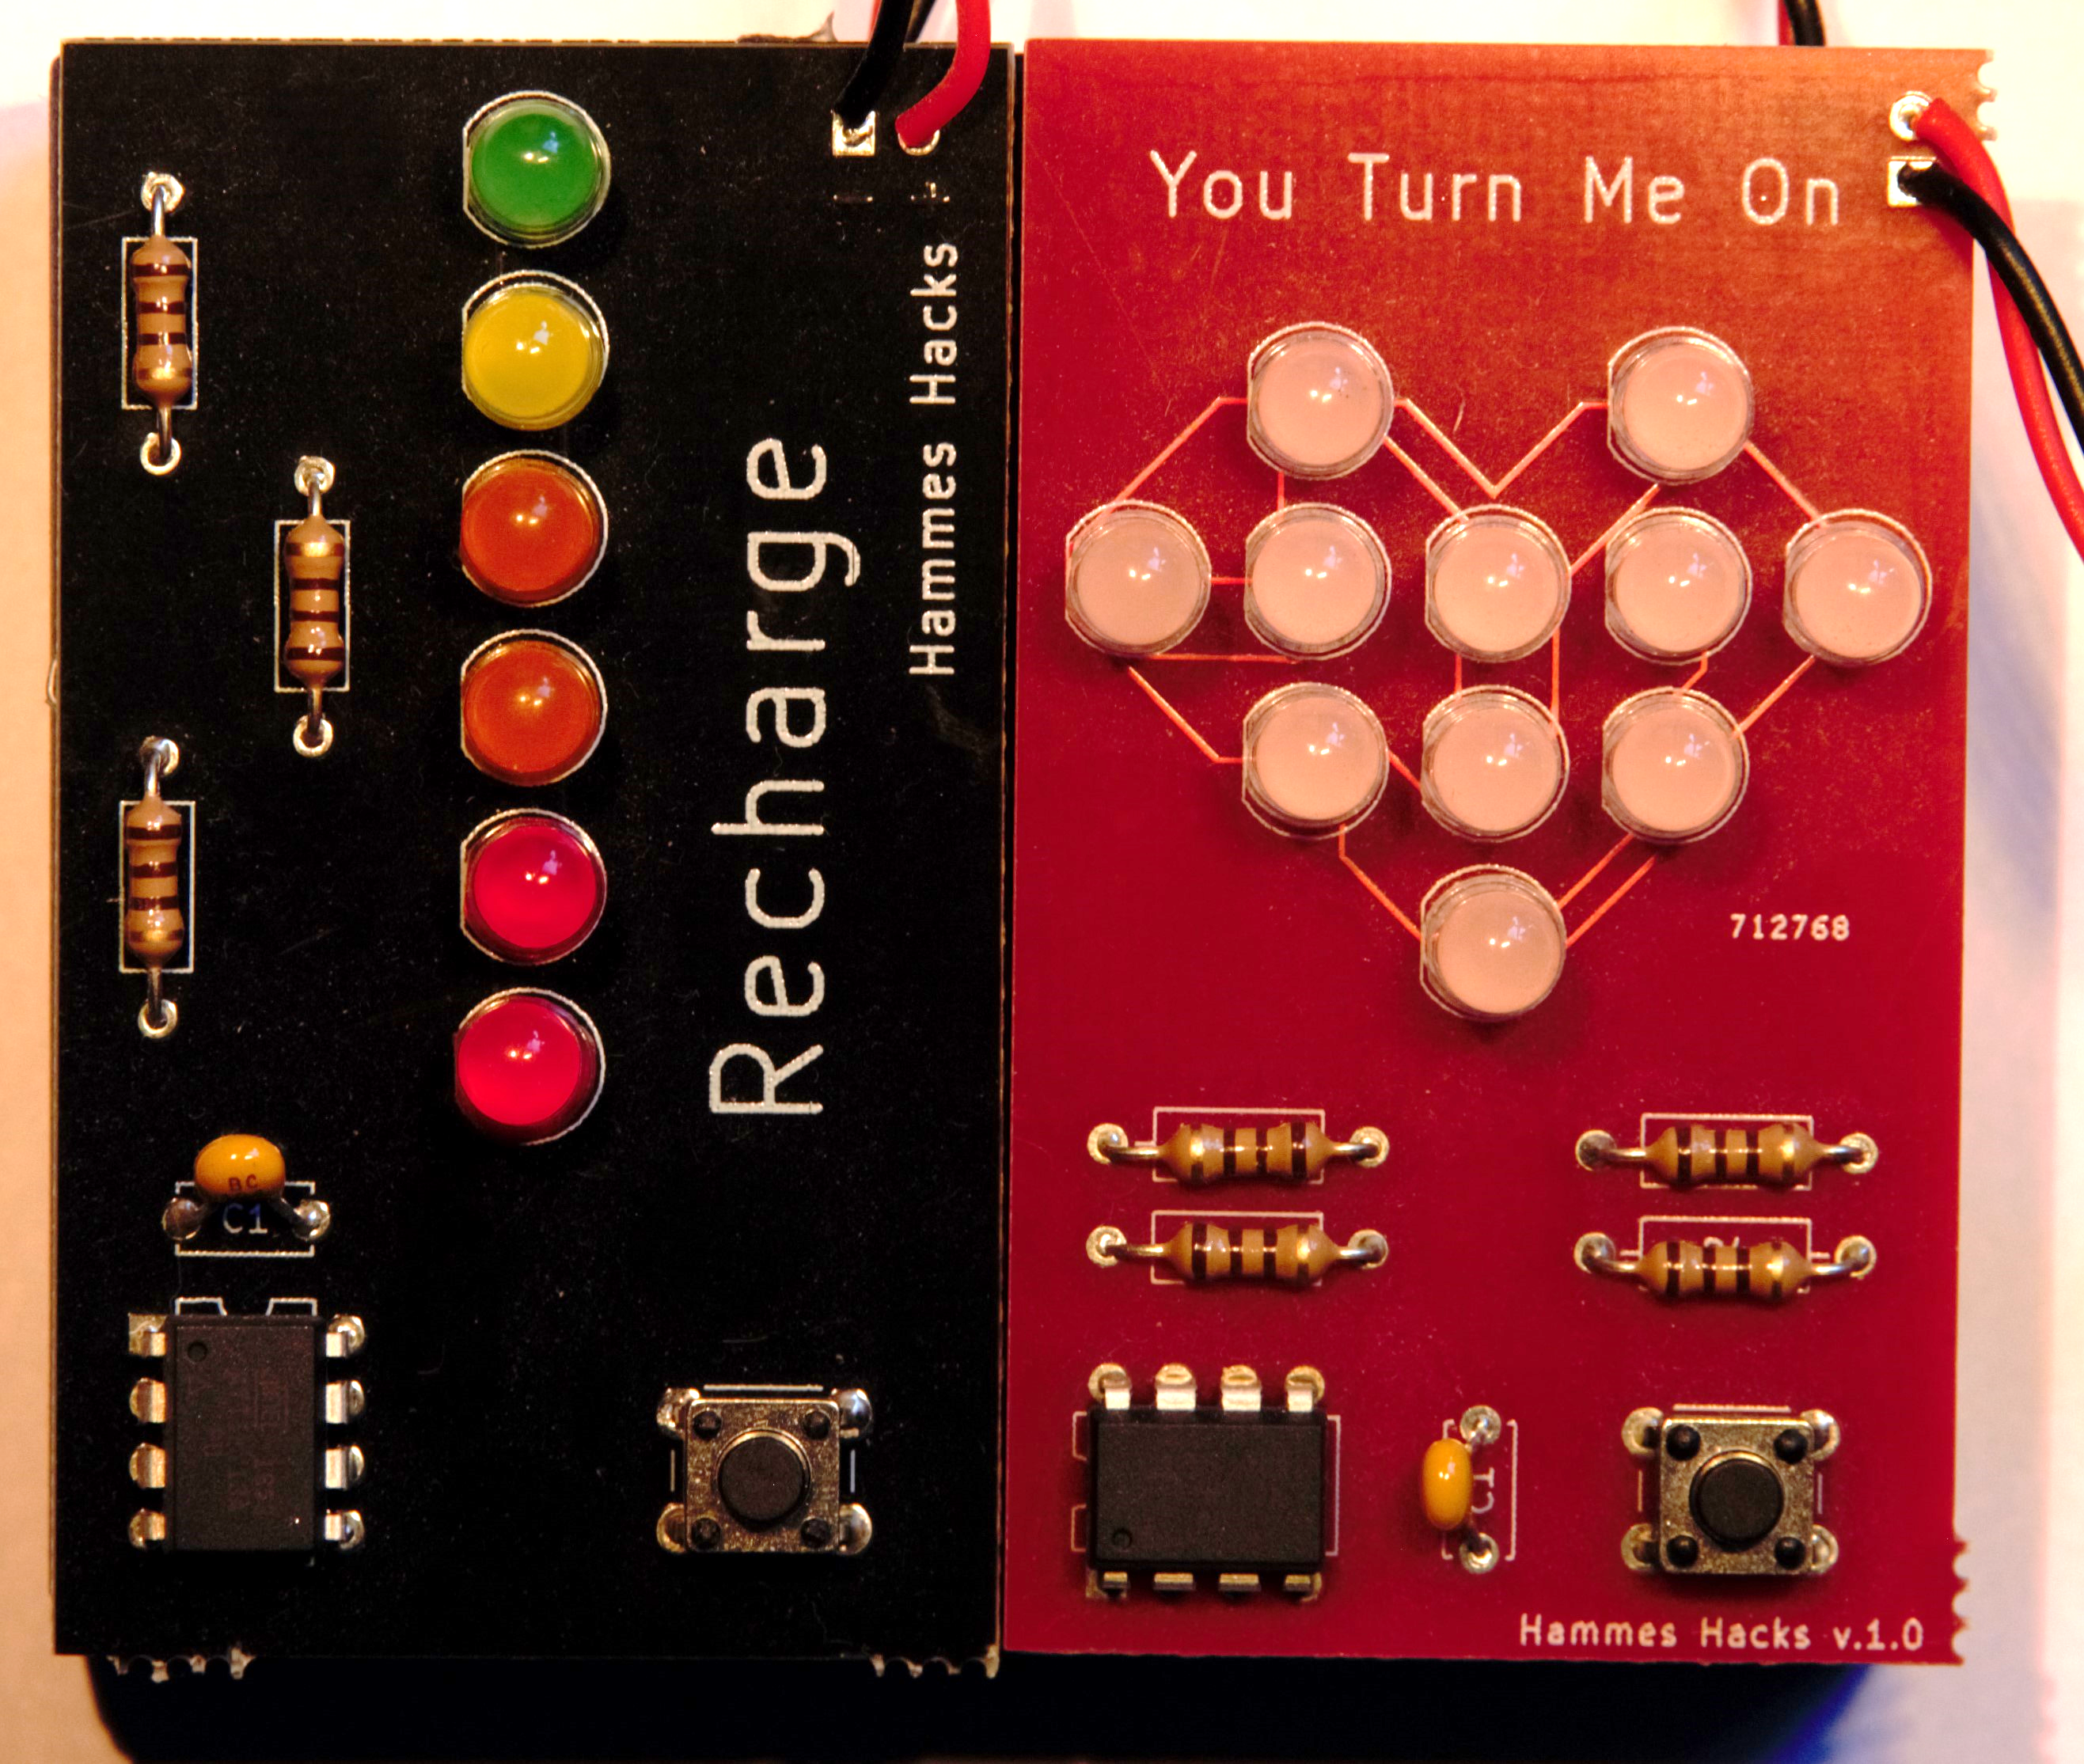
Soldering For Beginners: LED Toy Löten für Einsteiger: Wir bauen ein LED-Spielzeug
Solder a Recharge or a You Turn Me On kit (student choice)
Löten ein Recharge oder ein You Turn Me On kit
Day 3/Tag 3, 21:00-23:00

Slide 6
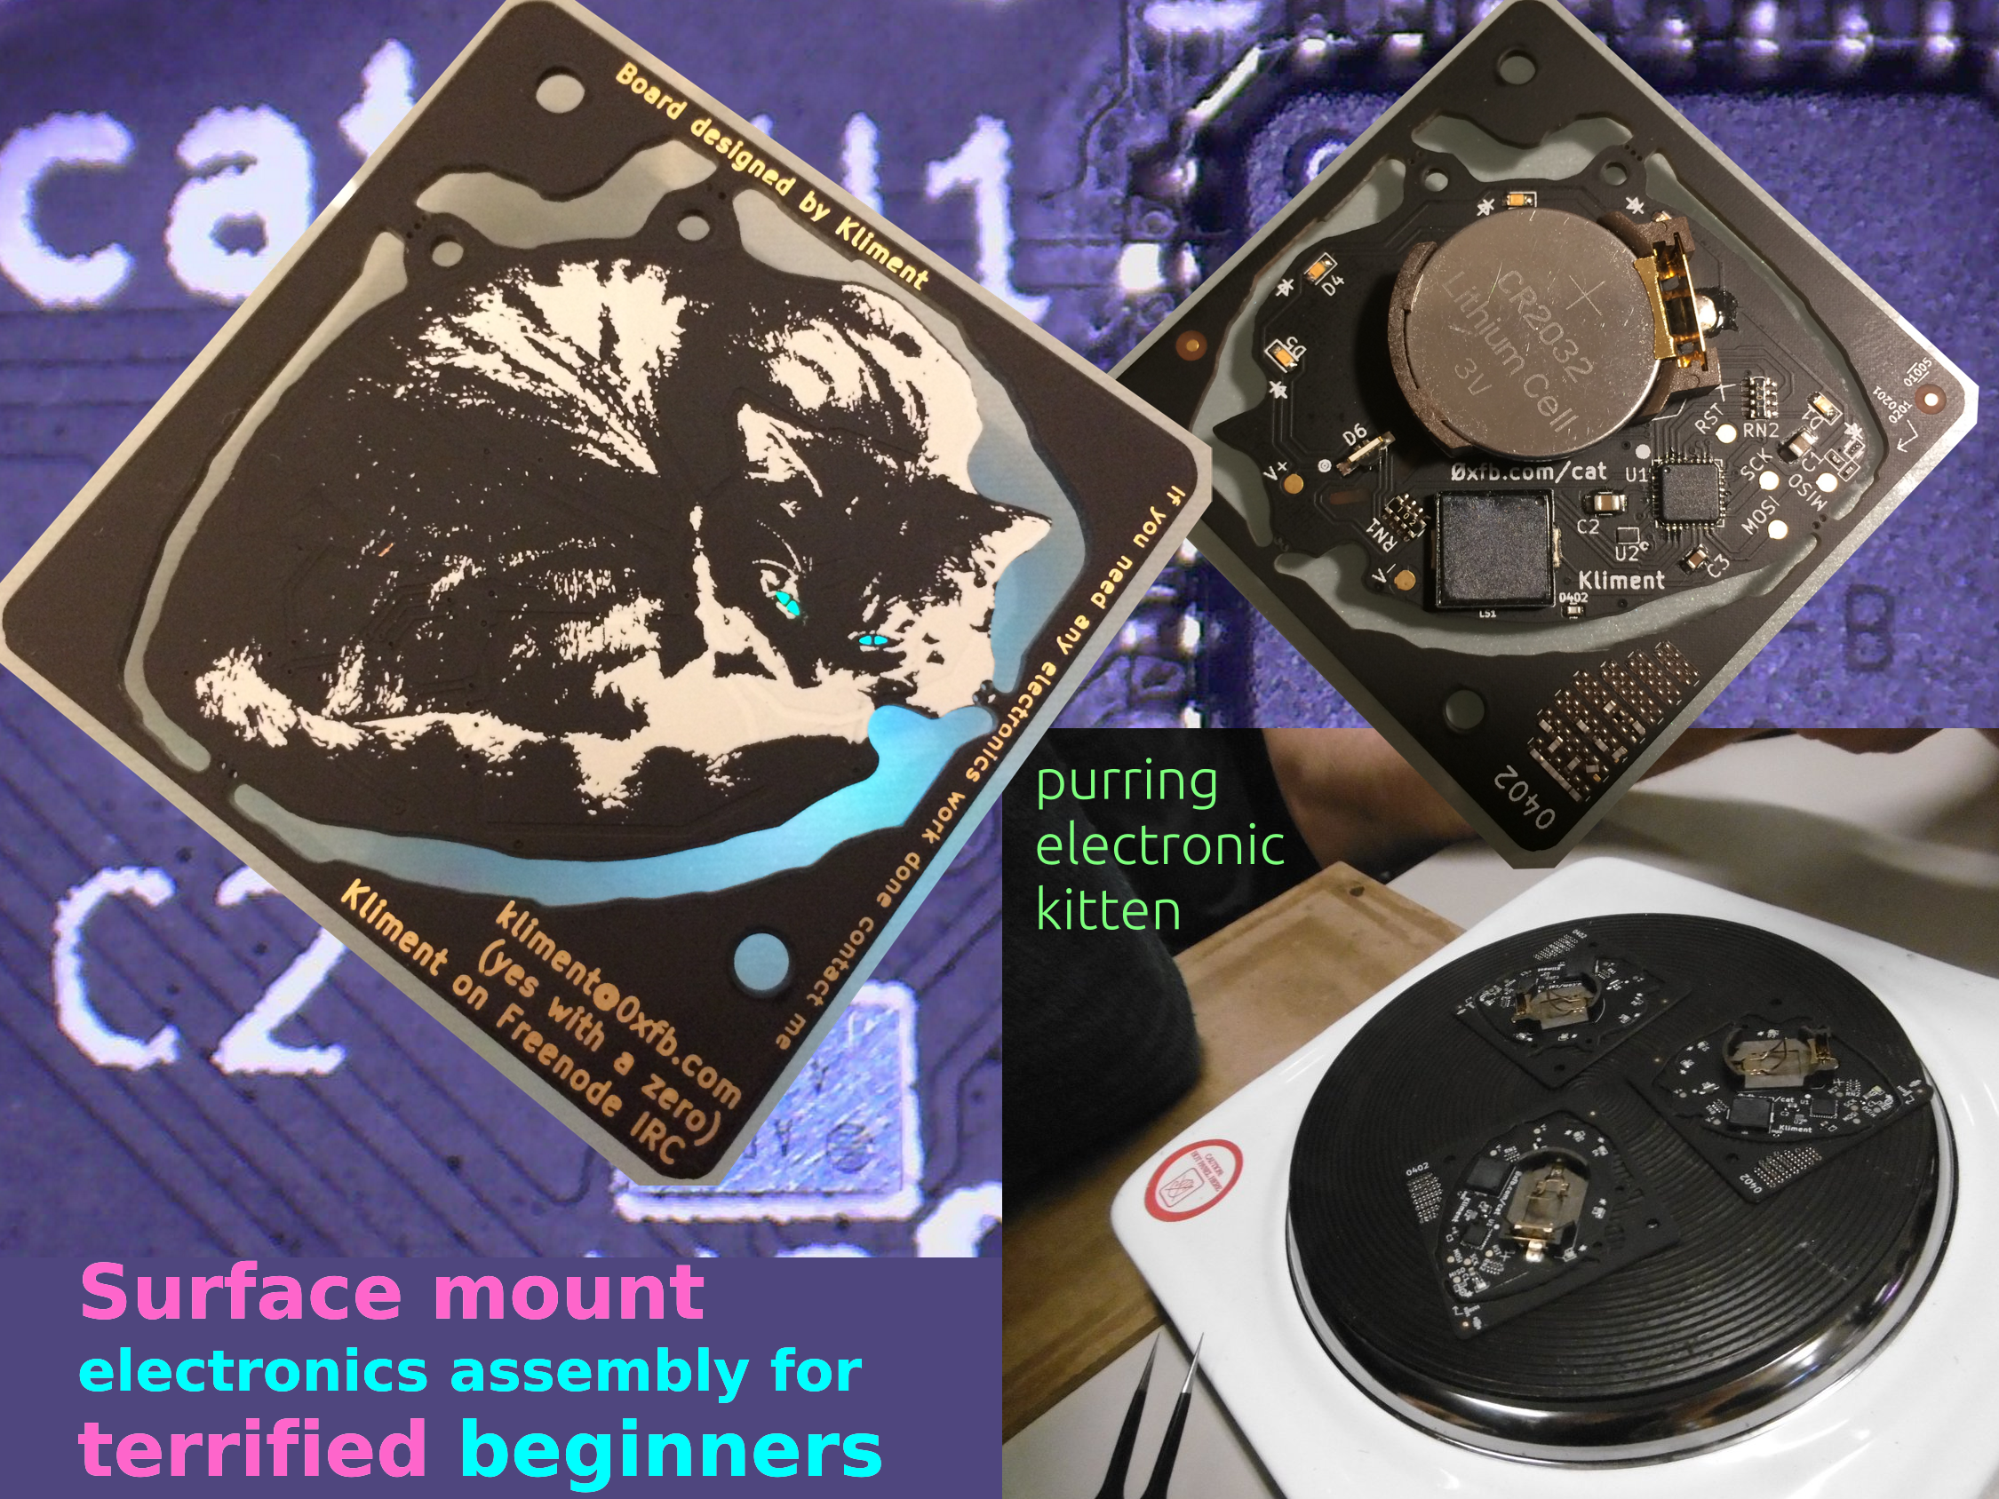
Surface mount electronics assembly for terrified beginners
Learn to use surface-mount parts
Handle microscopic parts (microscopes available)
Build an electronic kitten
20 Euro
Workshops Daily!

Slide 7
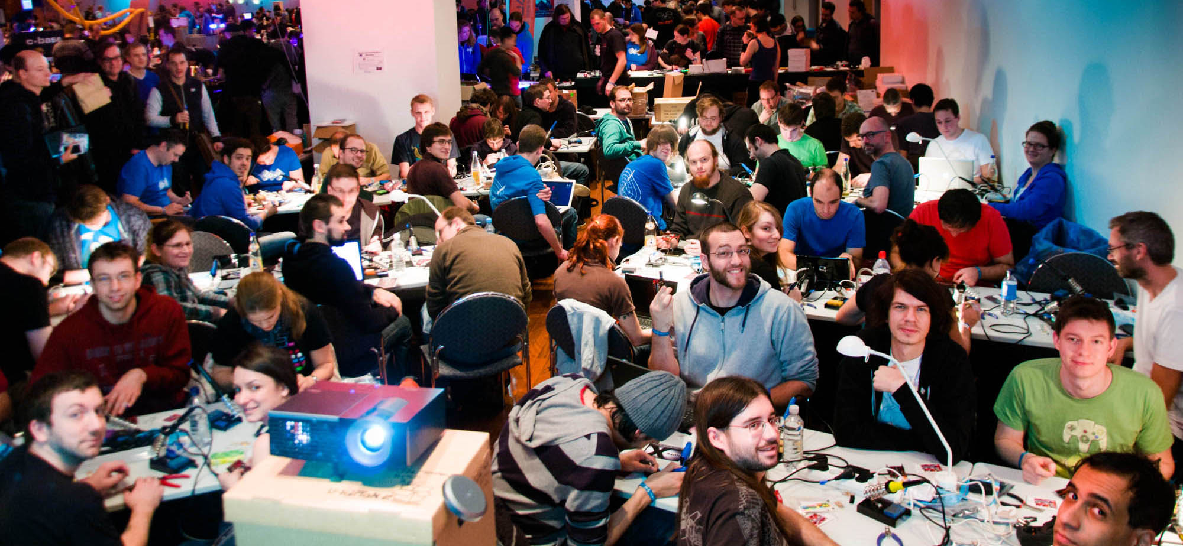
Arduino For Total Newbies
Learn everything you need in 3.5 hours!
35 Euro
Day 3, 13:00

Slide 8
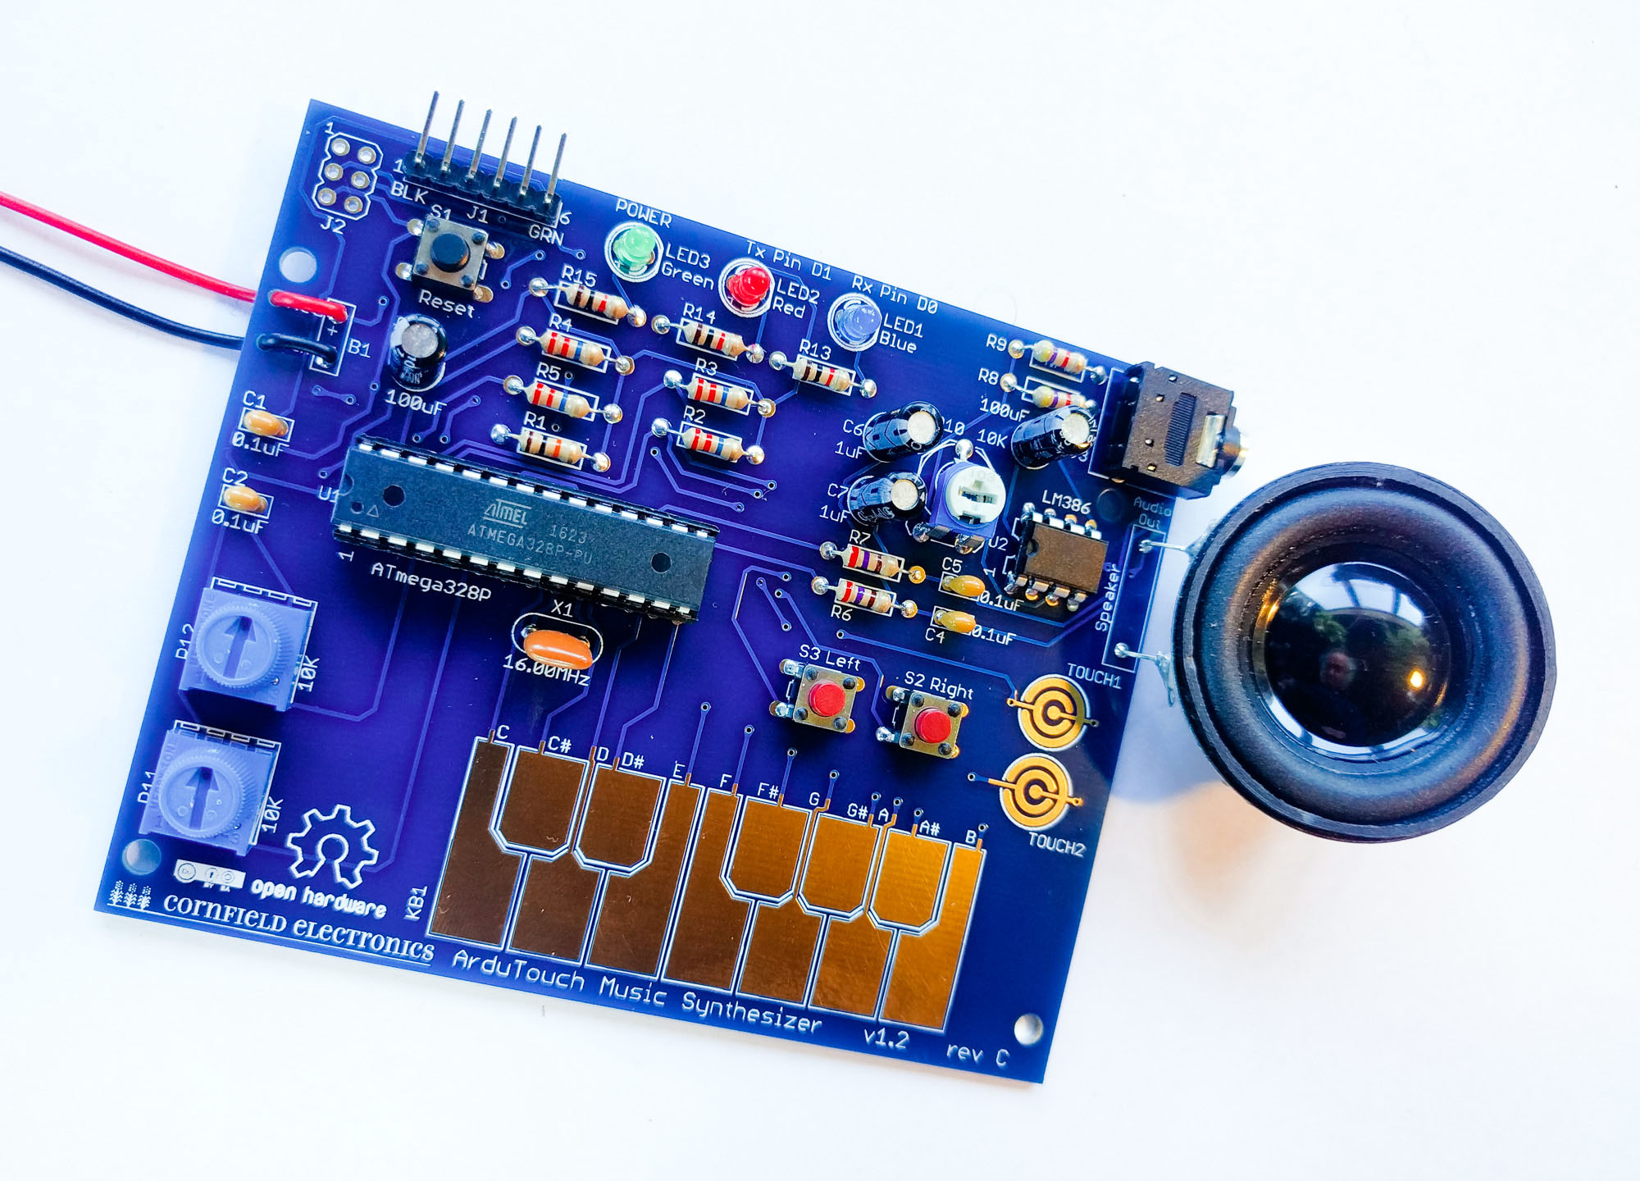
ArduTouch music synthesizer
Make your own music synthesizer musical instrument
Make beautiful music (and noise).
30/35 Euro
Day 4, 12:00

Slide 9
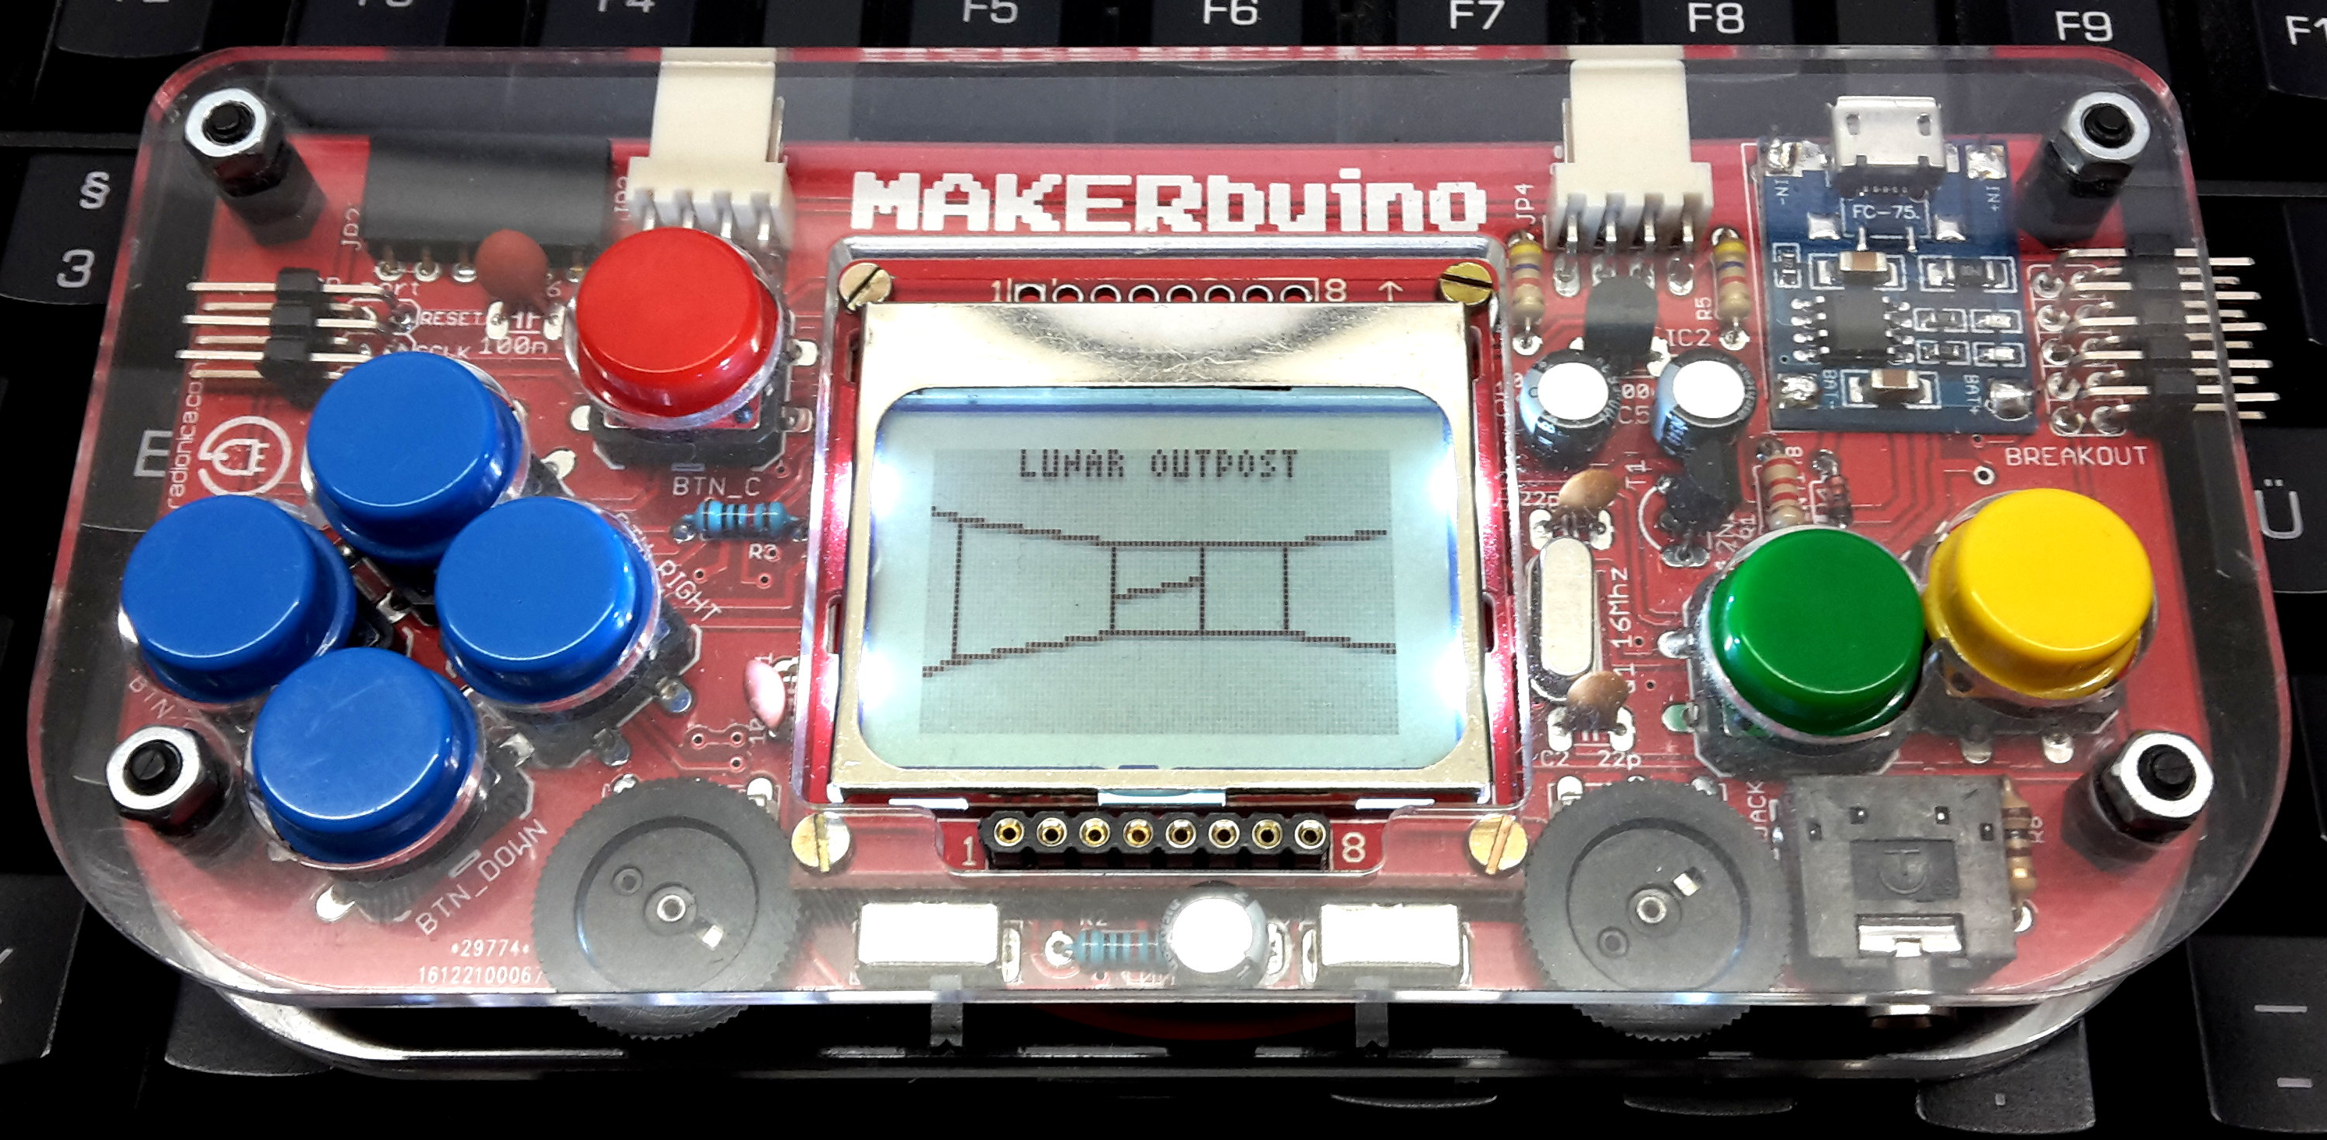
MAKERbuino building session
Build a gaming console!
For kids with soldering experience
55 EUR
Day 3, 10:00 am

Slide 10
Build your own Geiger counter with WiFi and LoRaWAN
Multigeiger selber löten für alle
Mit LoRaWAN und WiFi @HHA
Mach mit beim Messnetz Radioaktivität!
75 Euro
Day 3, 14:00-16:00
Day 4, 10:00-12:30

Slide 11
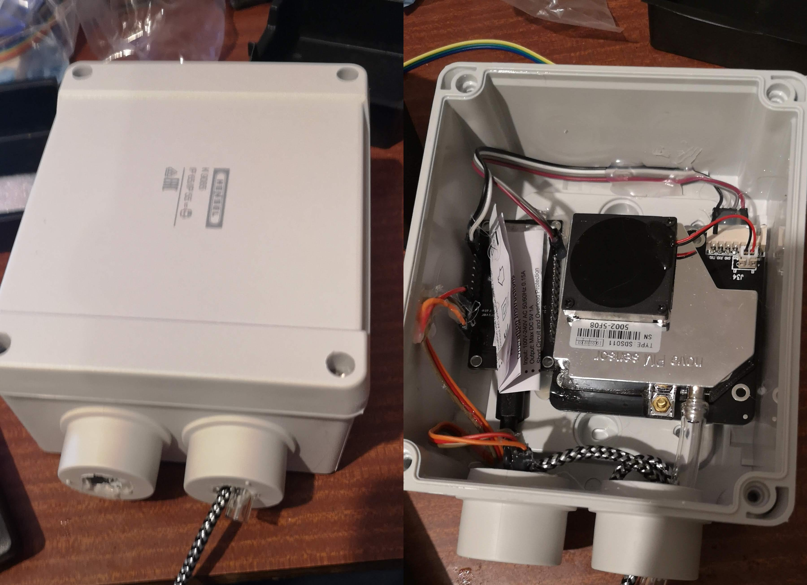
Air Quality Particulate Matter Sensor Workshop
Measure local Air Pollution
Join in a citizen science project
€50 EUR
Day 3, 18:00

Slide 12
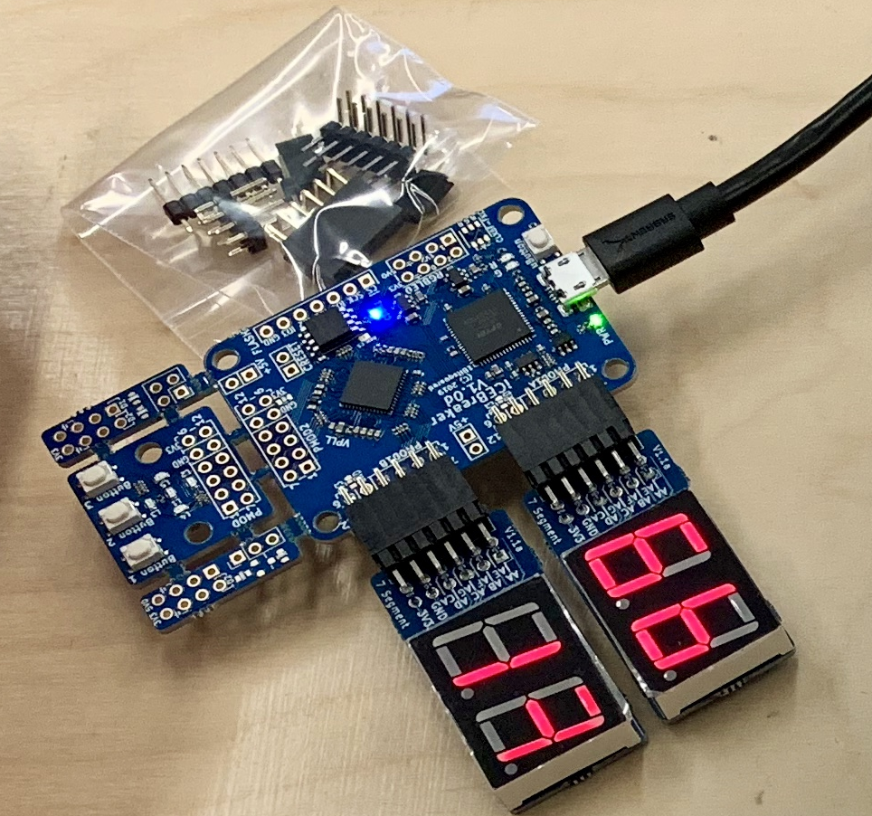
iCEBreaker FPGA Workshop
For beginners and pros
Getting Started using open-source FPGA Tools
Design digital logic
Day 2, 21:00-23:00

Slide 13
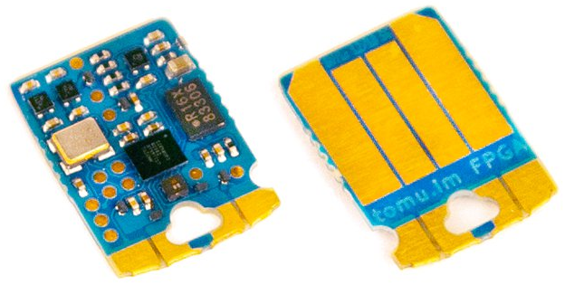
Fomu, the FPGA in your USB Port
Workshop for programmers afraid of FPGAs
Starts high level and then dives deeper
Free dev board for attendees!
Day 2 + Day 3, 23:00

